Slide 1

SOFTWARE ENGINEERING AND PROJECT MANAGEMENT (CSE 227)
Department of Computer Science and Engineering
School of Engineering,
PRESIDENCY UNIVERSITY

Slide 2
Module 4: Software Project Management (13 hrs) – Application level
Project Management Concepts, Project Planning, Overview of metrics, Estimation for Software projects, Project Scheduling, Risk Management, Maintenance and Reengineering, Software Process Improvement (SPI): CMM Levels.

Slide 3
Project Planning
Department of Computer Science and Engineering
School of Engineering, Presidency University

Slide 4
Project Activity Planning
Project Activity Planning happens before the Scheduling phase.
Here, activities (tasks) are identified.
“Network Planning Models” are created that sequence the tasks based on logical relationship, and subsequently schedule based on the resource constraints. In this, the project’s activities and their relationships are modelled as a network, in which time flows from left to right.

Slide 5
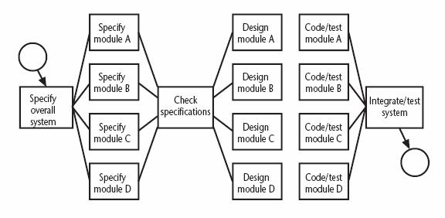
Network Planning Model: Activity-on-Arrow
Used to visualize the project as a network
Activities are drawn as arrow joining circles, or nodes, which represent the possible start and/or completion of an activity or set of activities
Sample Fragment of a network developed as activity-on-node

Slide 6
Formulating a Network Model
Constructing Precedence Network Rules-I
A project network should have only one start node
More than one activity starting at once? Invent a ‘start’ activity with zero duration
A project network should have only one end node
If necessary, invent an ‘end’ activity
A node has duration
Links normally have no duration

Slide 7
Formulating a Network Model
Constructing Precedence Network Rules-II
Precedents are the immediate preceding activities
All have to be completed before an activity can be started
Time moves from left to right
A network may not contain loops
A network should not contain dangles
If necessary, connect to the final node

Slide 8
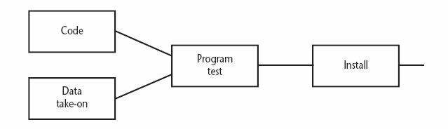
Formulating a Network Model
Fragment of Precedence Network
Installation cannot start until program testing is completed
Program test cannot start until both code and data take-on have been completed

Slide 9
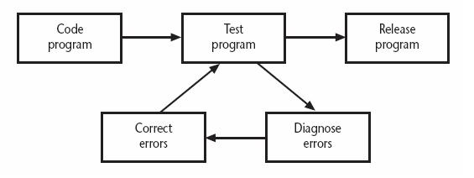
Formulating a Network Model
Network contains Loop
A loop is an error in that it represents a situation that cannot occur in practice
Program testing cannot start until errors have been corrected?

Slide 10
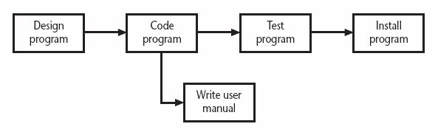
Formulating a Network Model
A Dangle
A dangling activity such as “write user manual” should not exist as it is likely to lead to errors in subsequent analysis

Slide 11
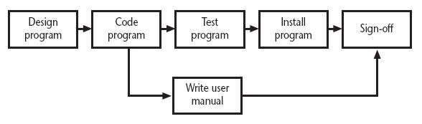
Formulating a Network Model
Resolving the Dangle
The figure implies that the project is complete once the software has been installed and the user manual written
We should redraw the network with a final completion activity

Slide 12
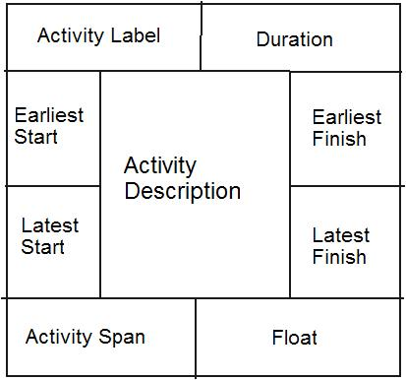
Formulating a Network Model
Labelling Convention

Slide 13
Critical Path Approach
Planning the project in such way that it is completed as quickly as possible
Identifying delayed activities
The method requires the estimation of duration of each activity
Forward pass: Calculate the earliest dates at which activities may commence and the project completed
Backward pass: Calculate the latest start dates for activities and the critical path

Slide 14
Estimated Activity Duration of A Project
Activity |  | Duration (weeks) | Precedents
A | Hardware selection | 6
B | Software design | 4
C | Install hardware | 3 | A
D | Code & test software | 4 | B
E | File take-on | 3 | B
F | Write user manuals | 10
G | User training | 3 | E,F
H | Install & test system | 2 | C,D

Slide 15
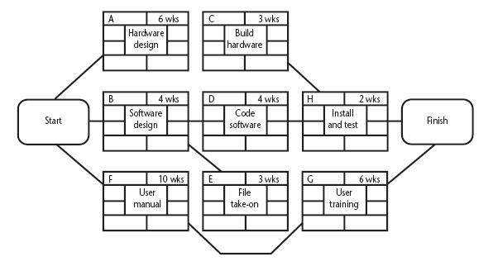
Precedence Network for the Project
3 WKS

Slide 16
The Forward Pass Calculation of Earliest Start Date - I
Activities A, B and F may start immediately
The earliest date for their start is zero
Activity A will take 6 weeks
The earliest it can finish is week 6
Activity F will take 10 weeks
The earliest it can finish is week 10

Slide 17
The Forward Pass Calculation of Earliest Start Date - II
Activity C can start as soon as A has finished
Its earliest start date is week 6
It will take 3 weeks, so the earliest it can finish is week 9
Activities D and E can start as soon as B is complete
The earliest they can each start is week 4
Activity D will take 4 weeks, so the earliest it can finish is week 8
Activity E will take 3 weeks, so the earliest it can finish is week 7

Slide 18
The Forward Pass Calculation of Earliest Start Date - III
Activity G cannot start until both E and F have been completed
It cannot start until week 10 - the later of weeks 7 (activity E) and 10 (for activity F)
It takes 3 weeks and finishes in week 13
Similarly, activity H cannot start until week 9 – the later of the two earliest finished dates for the preceding activities C and D

Slide 19
The Forward Pass Calculation of Earliest Start Date - IV
The project will be complete when both activities H and G have been completed
The earliest project completion date will the later of weeks 11 and 13 – that is, week 13

Slide 20
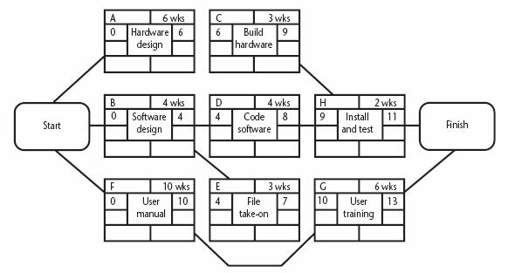
The Forward Pass The Network after the Forward Pass
3 WKS
3 WKS

Slide 21
The Backward Pass The Latest Activity Dates Calculation-I
The latest completion date for activities G and H is assumed to be week 13
Activity H must therefore start at week 11 at the latest (13-2) and the latest start date for activity G is week 10 (13-3)
The latest completion date for activities C and D is the latest date at which activity H must start – that is week 11
The latest start date of week 8 (11-3), and week 7 (10-3) respectively

Slide 22
The Backward Pass The Latest Activity Dates Calculation-II
Activities E and F must be completed by week 10
The earliest start dates are weeks 7 (10-3) and 0 (10-10) respectively
Activity B must be completed by week 7 (the latest start date for both activities D and E)
The latest start is week 3 (7-4)

Slide 23
The Backward Pass The Latest Activity Dates Calculation-III
Activity A must be completed by week 8 (the latest start date for activity C)
Its latest start is week 2 (8-6)
The latest start date for the project start is the earliest of the latest start dates for activities A, B and F
This week is week zero
It tells us that if the project does not start on time it won’t finish on time

Slide 24
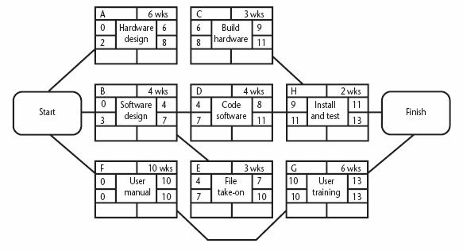
The Backward Pass The Network after the Backward Pass
3 WKS

Slide 25
Identifying the Critical Path
Critical path: One path through the network that defines the duration of the project
Any delay to any activity of this critical path will delay the completion of the project

Slide 26
Identifying Float and Span
Activity’s float: the difference between an activity’s earliest start date and its latest start date (or, equally, the difference between its earliest and latest finish dates)
A measure of how much the start date or completion of an activity may be delayed without affecting the end date of the project
Activity span: the difference between the earliest start date and the latest finish date
Measure of maximum time allowable for the activity

Slide 27
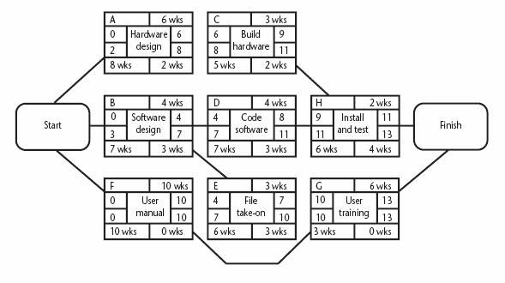
The Critical Path for the Example
3 WKS

Slide 28
Significance of the Critical Path
In managing the project, we must pay particular attention to monitoring activities on the critical path
The effects on any delay or resources unavailability are detected and corrected at the earliest opportunity
In planning project, it is the critical path that we must shorten if we are to reduce the overall duration of the project

